Slide 1
Transformer Interpretability
Beyond Attention Visualization
Proceedings of the IEEE/CVF Conference on Computer Vision and Pattern Recognition. 2021
Chefer⁽¹⁾, Hila, Shir Gur⁽¹⁾, and Lior Wolf^{(1,2)}
⁽¹⁾The school of computer Science, Tei Aviv Univ
⁽²⁾Facebook AI Research (FAIR)
박상민 / 오민아 / 유재상

Slide 2
Contents
Background
Related works
Method
Experiments
Results
Conclusion

Slide 3
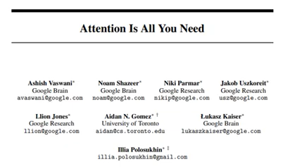
Deep learning based machine translation development process
Background
RNN
LSTM
Seq2Seq
Attention
Transformer
(1986)
(1997)
(2014)
(2015)
(2017)
기본 시퀀스 모델
Long term dependency 보완
Encoder - decoder 사이에 고정된 크기의 context vector 사용
Context vector 소스 문장 압축 → 병목 발생 → 성능 하락
decoder는 encoder 전체에서 정보 추출
모든 hidden state는 여전히 RNN 통해 추출
RNN 없이 오직 Attention만 사용하는 아키텍처

Slide 4
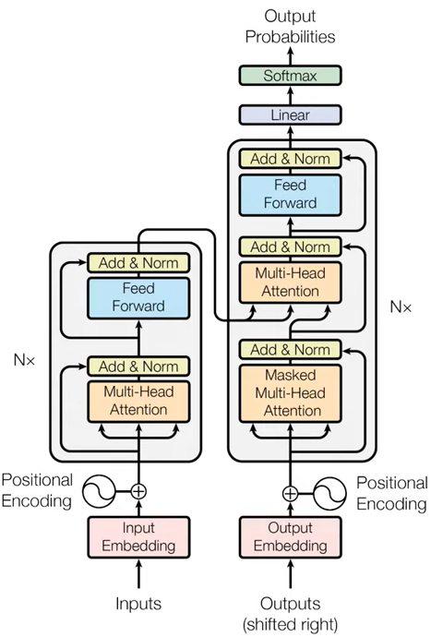
Transformer
Background
2nd Multi-head Attention
Encoder-Decoder Attention:
decoder의 단어가 encoder 문장 중 어떤 단어와 가장 연관성이 높은지 학습
마지막 encoder layer의
출력이 모든 decoder layer에 입력
성능 향상 위해 ‘Residual Learning’ 수행
1st Multi-head Attention
Self Attention:
각 단어가 서로 어떤 연관성을 갖는지 학습
Positional Encoding 사용하여 위치 정보 포함시킴

Slide 5
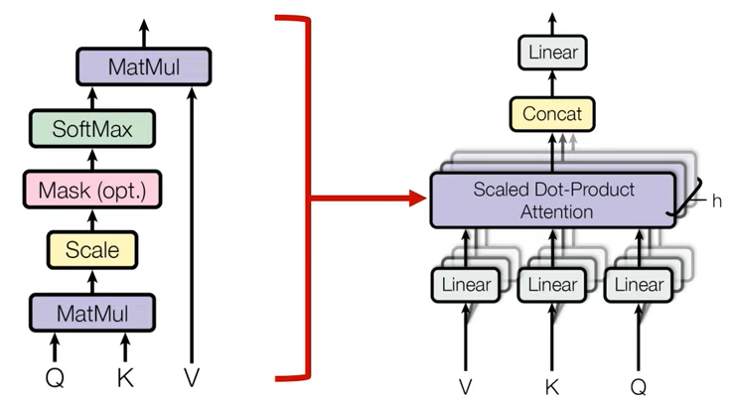
Transformer (Multi-head Attention)
Background
입력값과 출력값의 dimension을 맞추기 위해 일렬로 붙임
h
→ h 개의 서로 다른 K / Q / V
서로 다른 Attention concept을 학습하여 더욱더 구분되고 다양한 특징들을 학습하는 효과
입력값은 3개로 복제되어 각각 V/K/Q로 들어감

Slide 6
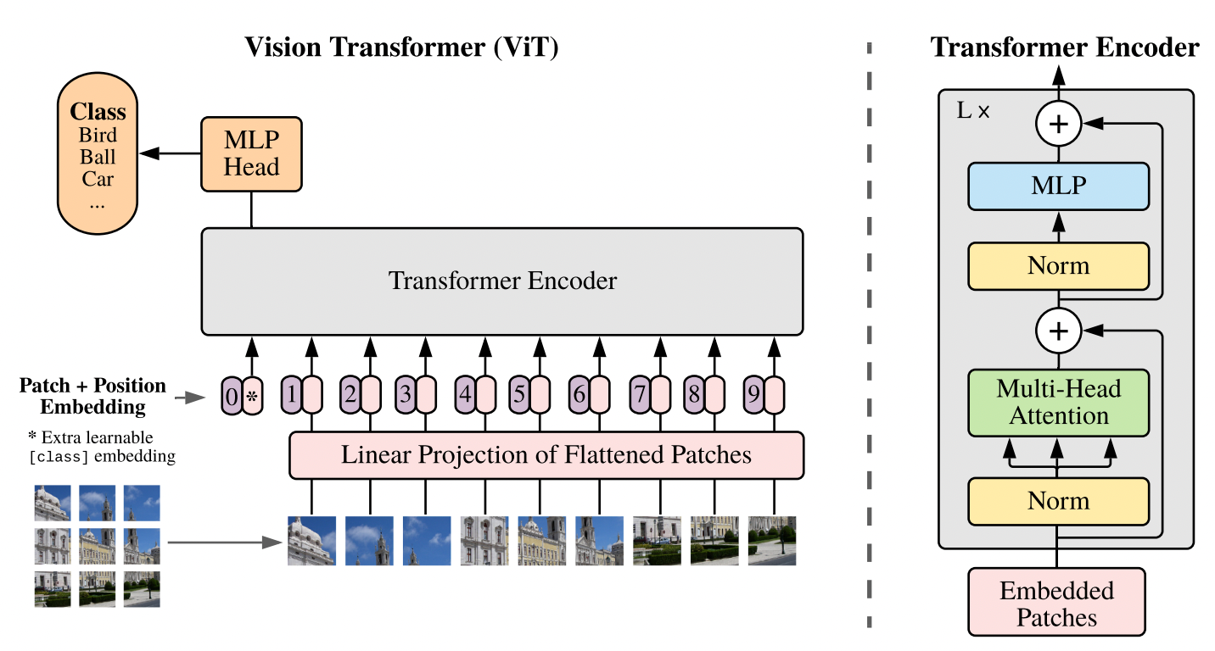
Vision Transformer
Related Work

Slide 7
Explainability in Computer Vision
Related Work
Gradient method
Based on the gradients with respect to the input of each layer
Attribution propagation method
Decompose, in recursive manner, the decision made by the network into the contributions of the previous layers, all the way to the element of the network’s input
Grad CAM method
Layer-wise Relevance Propagation(LRP) method

Slide 8
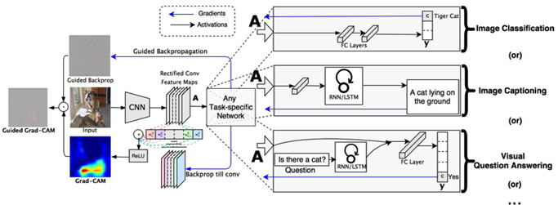
The Grad-CAM method
Related Work

Slide 9
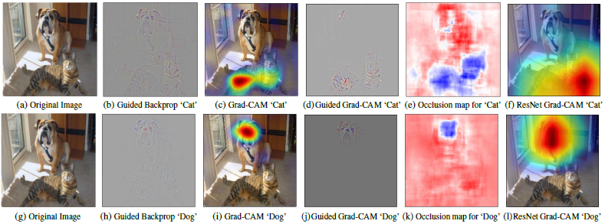
The Grad-CAM method
Related Work

Slide 10
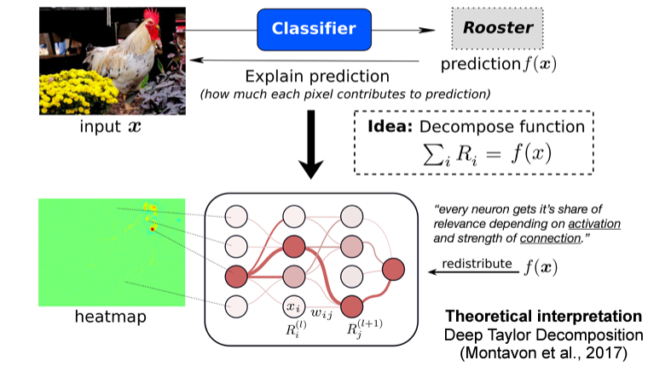
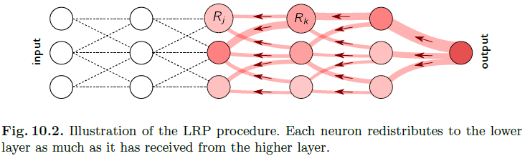
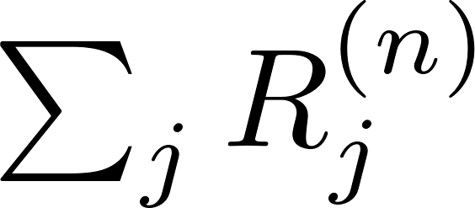
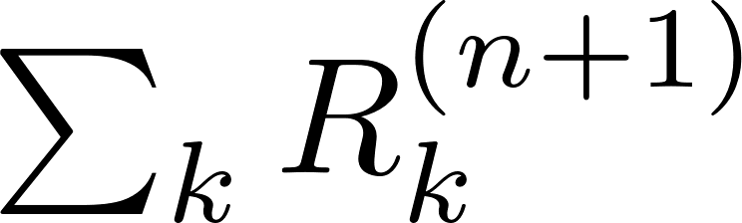
Layer-wise Relevance Propagation(LRP) method
Related Work
=

Slide 11
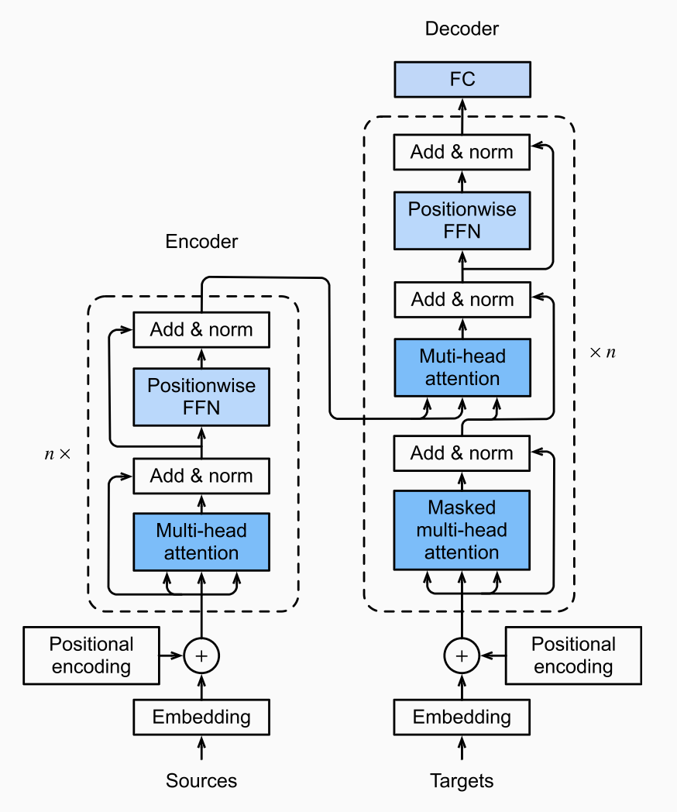
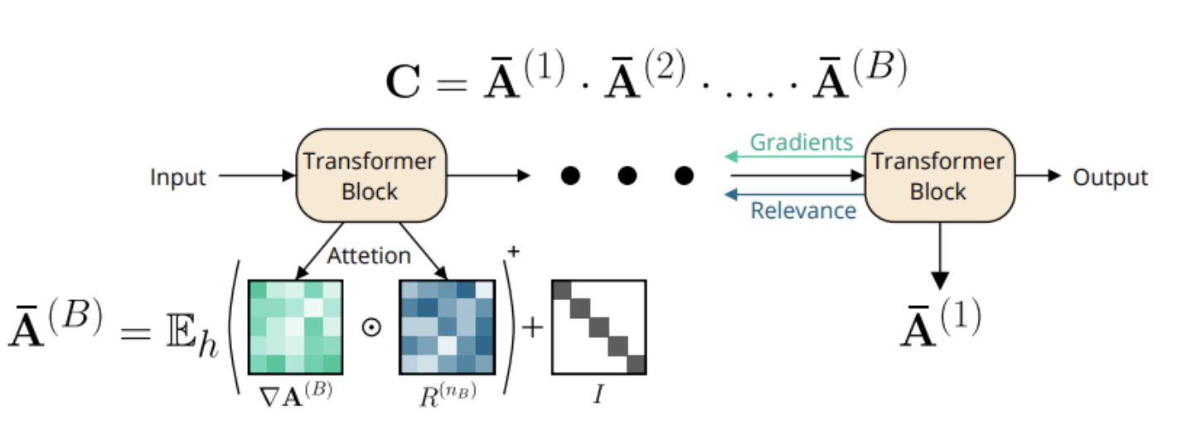
Overall Method to adapt LRP in transformer
Method
General Architecture
기존 문제점 (LRP 적용성에 대한)
Single layer
Transformer 의 attention score에 의존
Rollout method 처럼 시도는 있었으나 한계가 존재
LRP를 단순 접목하기 어려움
Multi layer
LRP with Gradient & Relevancy propagations

Slide 12
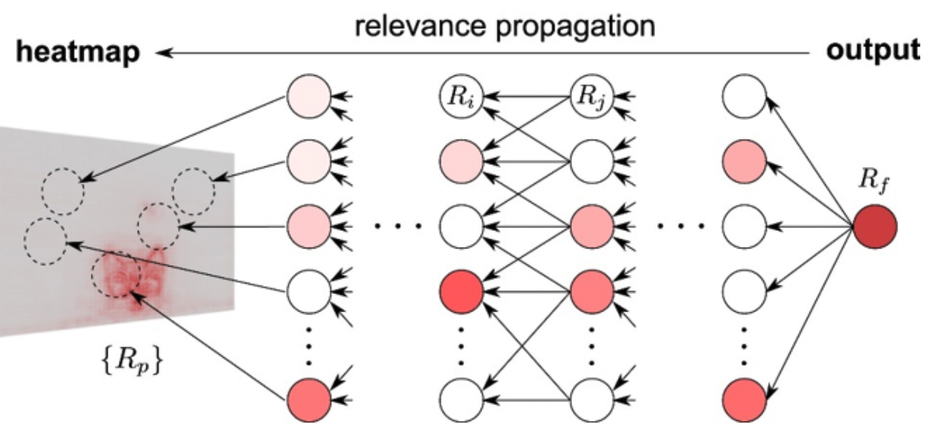
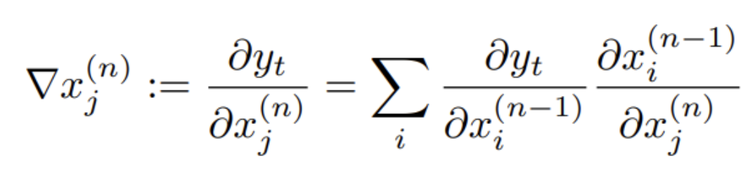
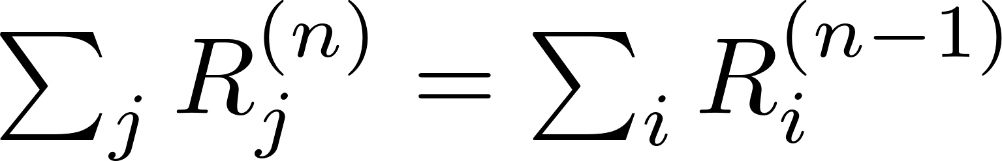
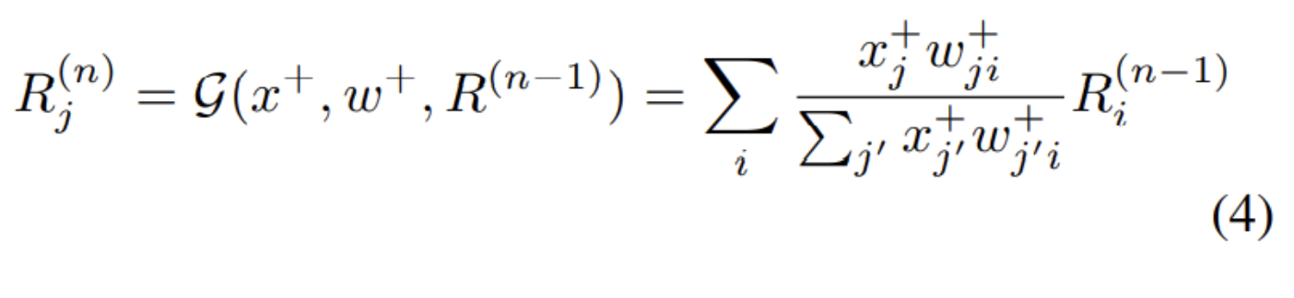
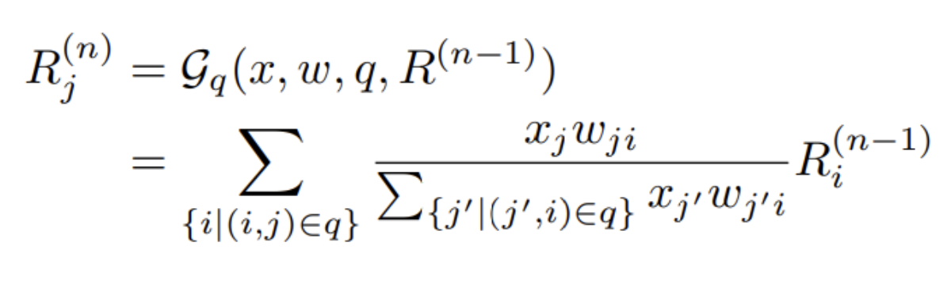
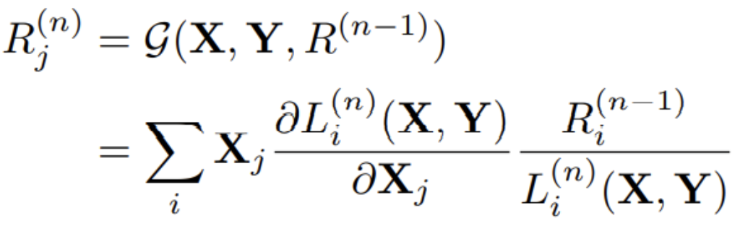
i) Gradients and Relevance
Method
Gradients (chain rule)
Relevance (Maintenance and Positive values)
Each layer’s total relevance is the same
Only considering positive values
Deep Taylor Decomposition
RELU
GELU for transformer

Slide 13
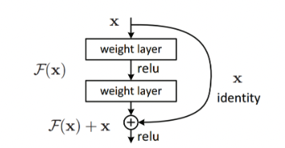
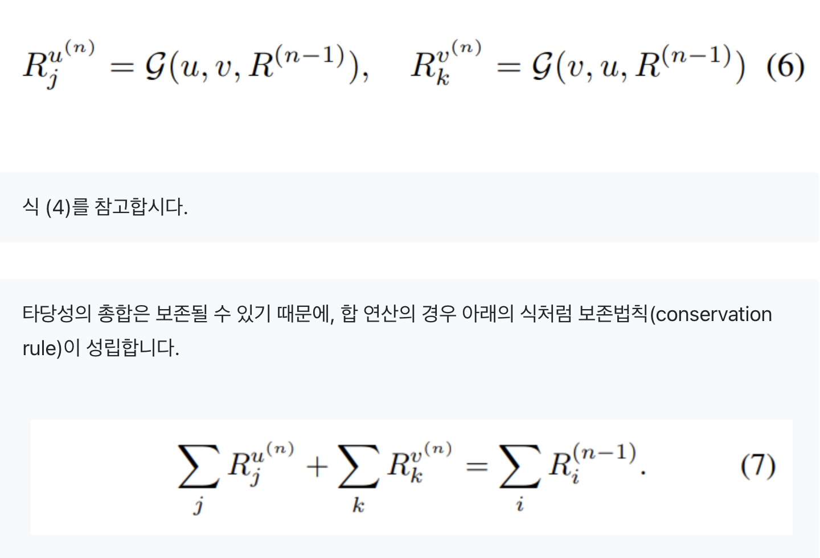
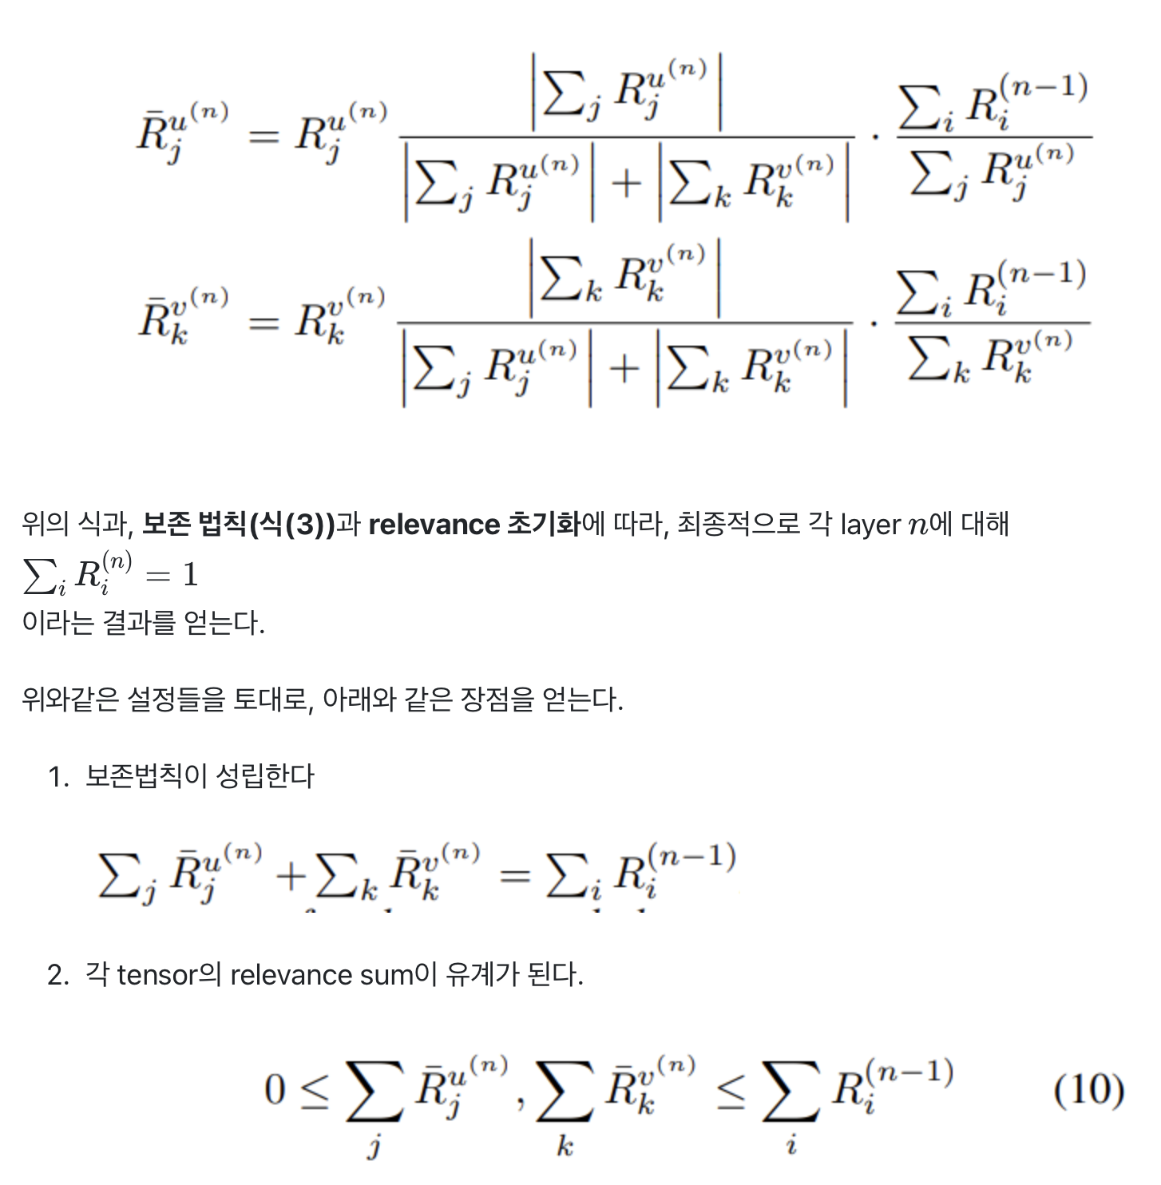
ii) How to adapt the issues in transformer
Method
Maintain with summation
Normalization for matching
Transformer 구조에서는 skip connection, Normalization, FNN 도 함께 고려됨
Skip connection 및 내부적인 inner product로 각 layer의 Relevance 총합은 instable 함

Slide 14
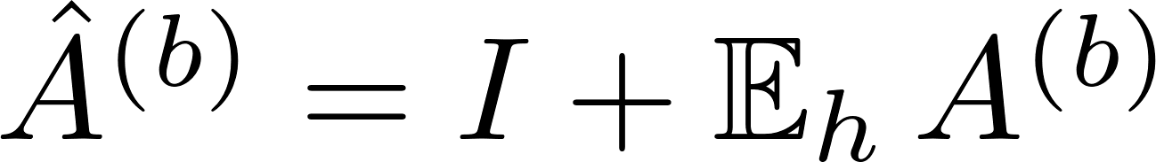
Illustration of the method
Method
Our method
The Roll out method
참고 : https://velog.io/@sjinu/논문리뷰Transformer-Interpretability-Beyond-Attention-Visualization

Slide 15
Task and Evaluation Settings
Experiments
The visual domain
Task: experiment with the pretrained ViT-base model, which consists of a BERTlike model
Evaluation :
Reporting: | negative and positive perturbations, results for segmentation
Dataset: | ImageNet (ILSVRC) 2012, ImageNet-Segmentation, containing 4,276 images from 445 categories
The linguistic domain
Task: experiment with the BERT-base model as our classifier, assuming a maximum of 512 tokens, and a classification token [CLS] that is used as the input to the classification head
Evaluation: ERASER and evaluate the reasoning for the Movies Reviews dataset, which consists of 1600/200/200 reviews for train/val/test

Slide 16
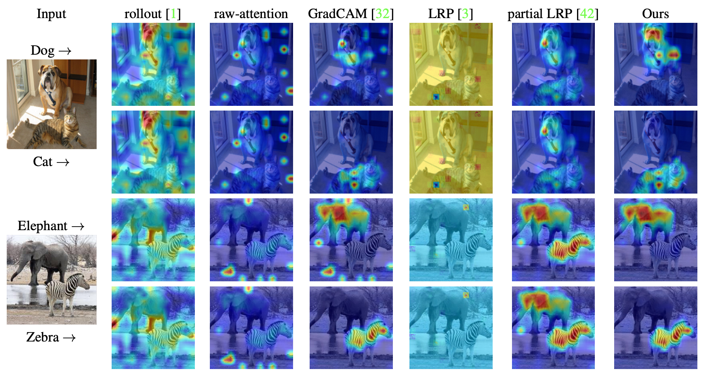
Re wrap-up the result and example
Results
Class-specific
Class에 따라서, 그에 따른 gradient 와 Relevance 값이 달라짐
Non-linearity
불필요한 부분이 highlight되는 이슈를 방지
참고 : https://velog.io/@sjinu/논문리뷰Transformer-Interpretability-Beyond-Attention-Visualization

Slide 17
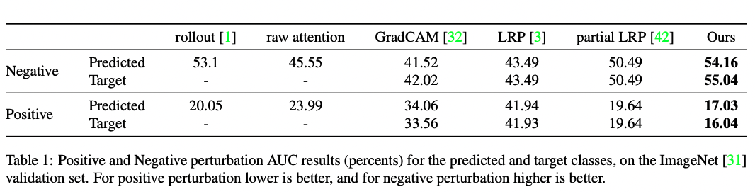
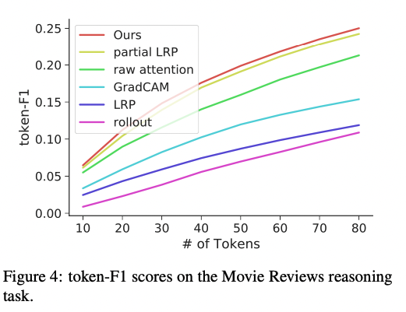
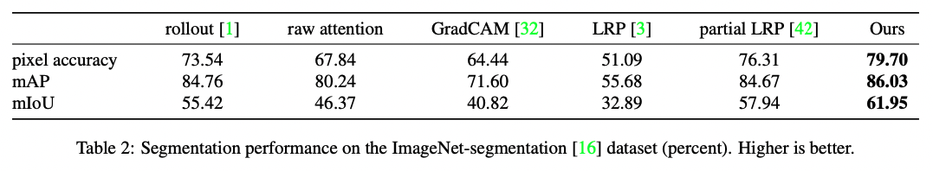
Other testing results
Results
i) Perturbation test
iii) Language reasoning
ii) Segmentation test

Slide 18
Conclusion
Conclusion
Multiple factors prevent methods developed for other forms of neural networks from being applied.
use of non-positive activation functions, the frequent use of skip connections, and the challenge of modeling the matrix multiplication that is used in self-attention.
Our method provides specific solutions to each of these challenges and obtains state-of-the-art results when compared to the methods of the Transformer literature, the LRP method, and the Grad Cam method, which can be applied directly to transformers.

Slide 19
THANK YOU :)

Slide 20
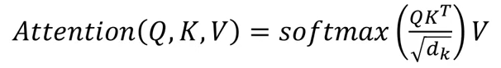
Attention
Appendix
Attention의 3가지 요소
Query
Key
Value
Key1
Scale
Softmax
(Attention Score)
Value1
X
Query1
Key2
Scale
Softmax
(Attention Score)
Value2
+
Attention
X
Key3
Scale
Softmax
(Attention Score)
Value3
X

